Slide 1
Chapter 18
Renewing the Sectional Struggle,
1848-1854

Slide 2
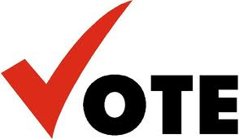
Popular Sovereignty and 1848
Election of 1848:
Lewis Cass (Democrat) vs. Zachary Taylor (Whig)
Lewis Cass believed slavery should be decided by POPULAR SOVEREIGNTY:
Belief that the people of a territory should decide the issue of slavery
Why is this good for politicians? Why is this good for people living there?

Slide 3
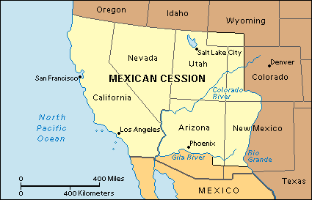
Free-Soil Party
Made up of both…
Free-Soilers:
Favored the Wilmot Proviso, against slavery in territories
Hated slavery because it took away job opportunities from whites (economic emphasis)
And, “Conscience Whigs”:
Condemned slavery on moral grounds

Slide 4



“Californy Gold”
Sutter’s Mill, CA (1848), gold is discovered
Gold paved the way for economic growth
1849:
CA drafted a constitution that forbade slavery
Asked Congress for admission, bypassing territory
South is upset, North is happy; potential upset to balance between free and slave states
South =
North =

Slide 5
Sectional Balance and Underground RR
South had many presidents, cabinet members, and justices
If they were outnumbered in the House, they had equal representation in Senate
Up until CA, 15 states were free, 15 were slave
Harriet Tubman
19 times she went to the South and rescued over 300 slaves
By 1850, Southerners demanded a new and more stringent fugitive slave-law

Slide 6
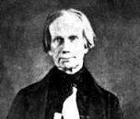
The Great Triumvirate
I’m back baby!
1849:
“Fire-eaters” in the South threatened secession
Henry Clay is back with…… (with Stephen Douglas)
Missouri Compromise, Nullification crisis
Favored concessions from both sides; North should yield by enacting tougher fugitive-slave law
John C. Calhoun, “The Great Nullifier”
Wanted to leave slavery alone, return runaway slaves
Daniel Webster:
Favored tough fugitive slave law “7th of March Speech”

Slide 7
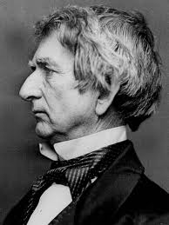
Deadlock….
William H. Seward:
Against concessions for the South
Slavery shouldn't be allowed in western territories due to a "higher law" than the Constitution
Taylor was against concession and threatened to veto it but…(next slide)

Slide 8
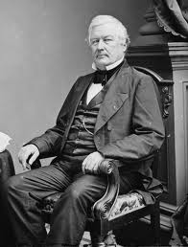
Compromise of 1850
Taylor dies in office, Millard Fillmore takes office, signs Compromise of 1850
CA admitted as free state
Slave trade illegal in D.C.
Popular Sovereignty in Mexican Cession: Utah and New Mexico
*More stringent fugitive-slave law
Texas received $10 million from federal gov’t for surrendering claim to disputed territory in New Mexico.

Slide 9
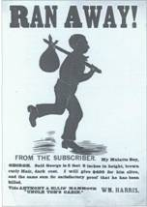
Balancing the Compromise Scales
Fugitive Slave Law of 1850 (“Bloodhound Bill”)
***Single most important frictional issue between the North and South in the 1850s***
Slaves could not testify on own behalf, denied a jury trial
Northerners who aided slaves could be fined/jailed
Effects of Slave Law:
Moderates join abolition bandwagon
“Personal Liberty Laws”: denied local jails to federal officials involved in catching slaves
Ableman v. Booth, 1859 -- Supreme Court upheld the Fugitive Slave Law.

Slide 10
Memory Aid for Comp. of 1850
POPFACT:
Popular Sovereignty in Mexican Cession
Fugitive Slave Law
Abolition of slave trade in Washington, D.C.
California admitted as a state
Texas given $10 million for disputed New Mexican territory.

Slide 11
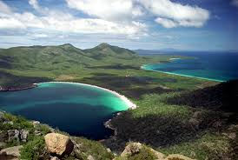
More US Expansion
Clayton-Bulwer Treaty (1850):
Neither Britain nor America would seek control over future isthmus waterways
Ostend Manifesto (Belgium):
Urged US to buy Cuba from Spain for $120 million
Free-soilers blocked the passage of this

Slide 12
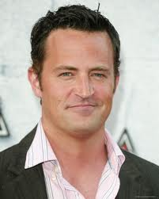
Overseas Expansion
Caleb Cushing:
Treaty of Wanghia (1844):
first diplomatic agreement between US and China, purpose was to promote commerce
Opened up missionaries for China
Chinese were also considered savages by Anglo-Americans
What other group is considered to be savage-like by whites?
1852, Everybody’s “friend” (Matthew Perry) opens up Japan
Treaty of Kanagawa (1854):
Japan and US begins trade after 200 years of Japanese isolation
Begins Meiji Restoration

Slide 13
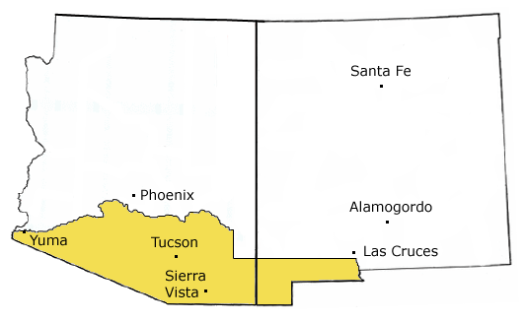
Gadsden Purchase
Desire to build RR to west coast, only one could be built: North or South?
South wins because of favorable geography
Jefferson Davis (Secretary of War and……) appoints William Gadsen to negotiate purchase of land
Gadsen Purchase (1853)
US pays $10 million to Santa Anna for area
How much did we pay for Louisiana Purchase? Mexican Cession?
Now consider who is having to pay and who is going to benefit?
Watch Jimmy Fallon’s skit!

Slide 14
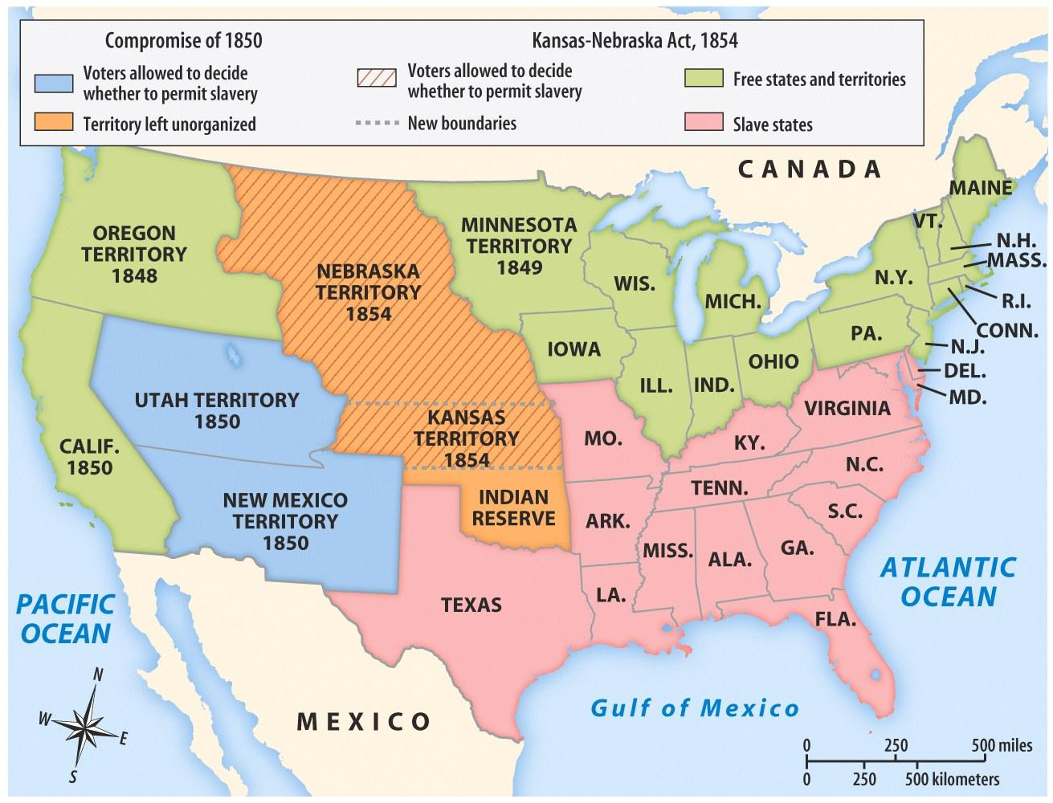
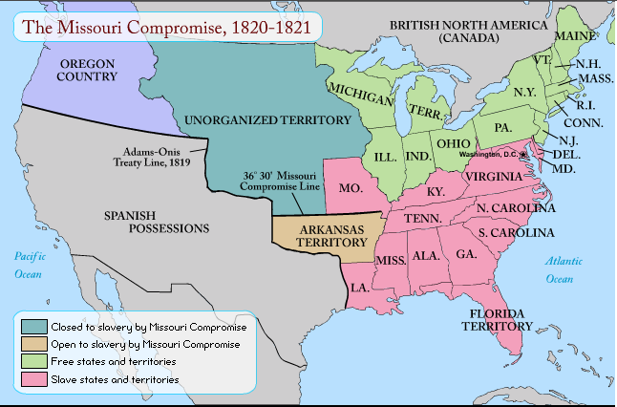

Kansas-Nebraska Scheme
Most important short-term cause of Civil War
Response to Gadsden Purchase
Territory of Nebraska would be split into two territories – Kansas and Nebraska
Slavery issue would be decided by popular sovereignty
Kansas would presumably become slave, Nebraska free
Repeal’s the Missouri Compromise of 1820 with 36˚30’ line
North is FURIOUS
North =

